Slide 1
MODULE -4
Indexing - Examples

Slide 2

An Example:
A file contains 16384 records. Each record size is 32 bytes and its key field is of size 6 bytes. The file is ordered on a non key field and the file organization is un spanned with the block size 1024 bytes and the size of the block pointer is 10 bytes. Construct a secondary index on the key field of the file and a multilevel index is used to store the secondary index. Compute the number of blocks needed at the first level and second level indexing.
Notes:
https://www.youtube.com/watch?v=fPk3TJODDwo

Slide 3
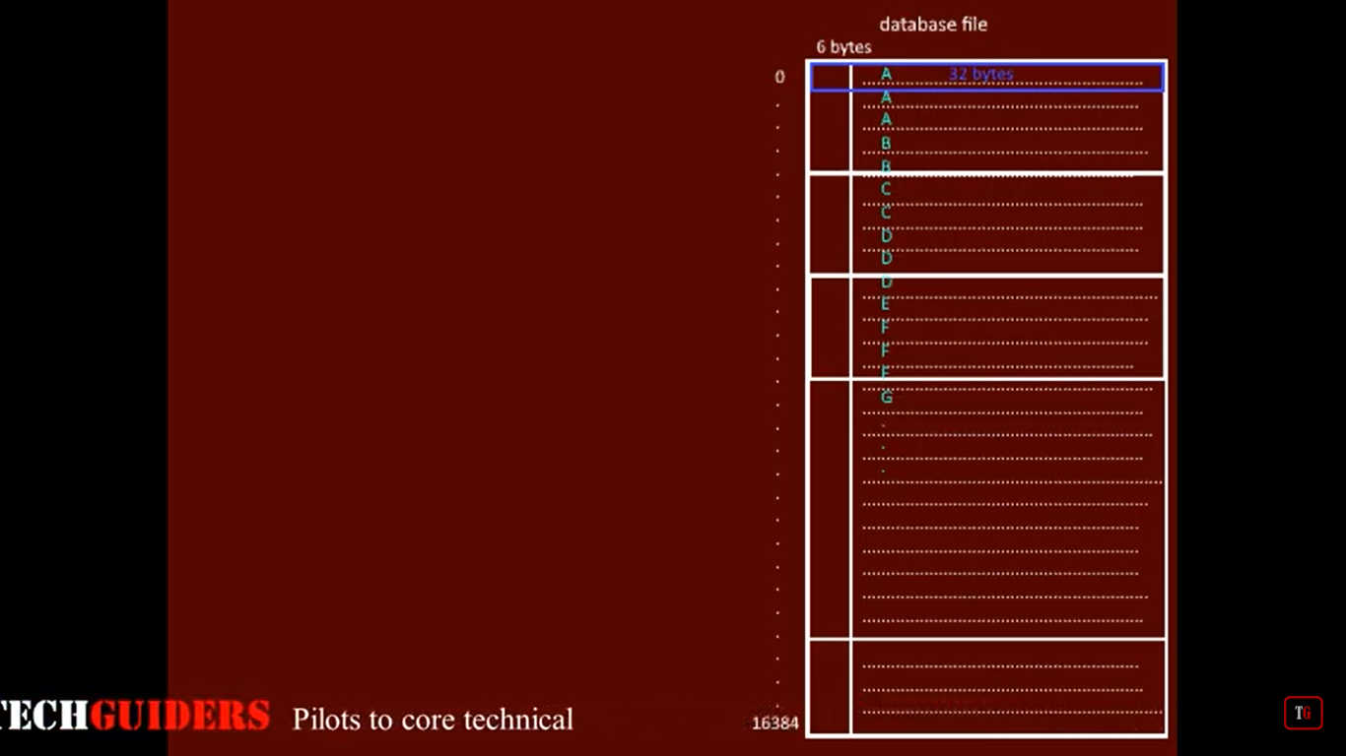
Solution:

Slide 4
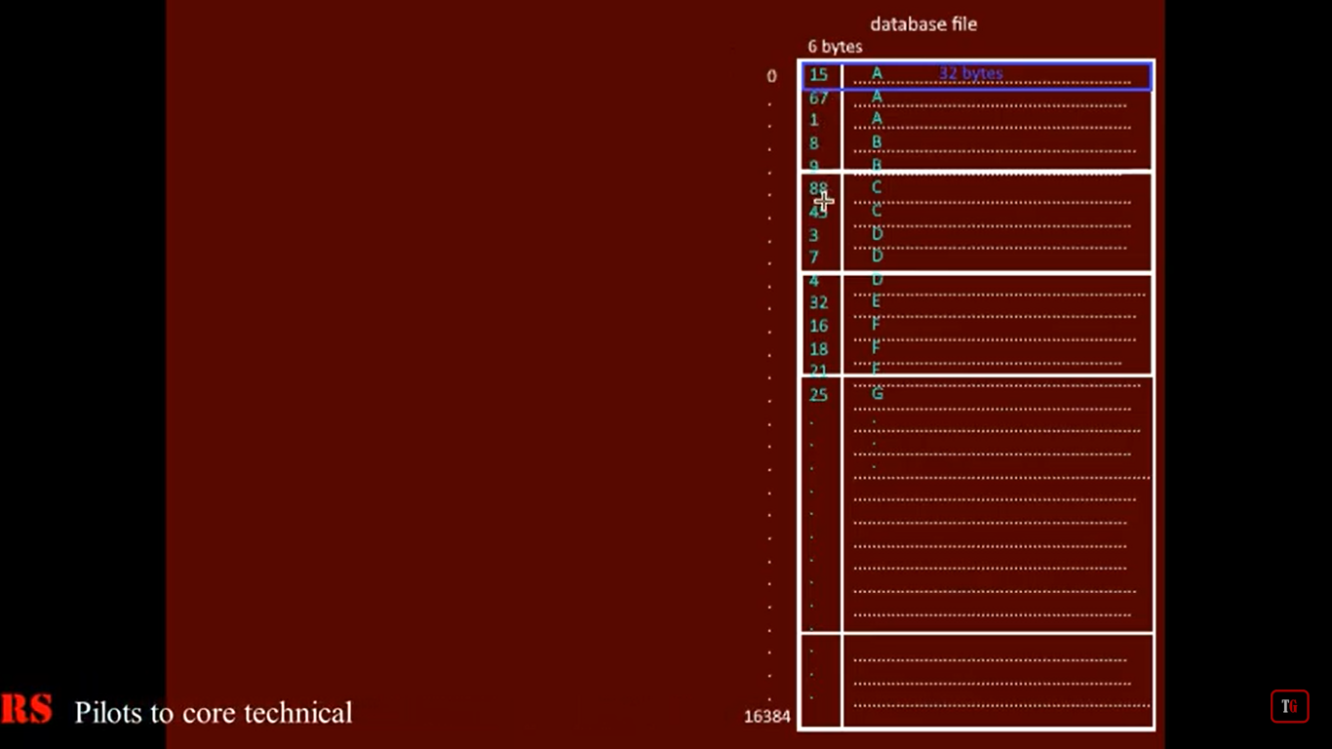
Solution:

Slide 5
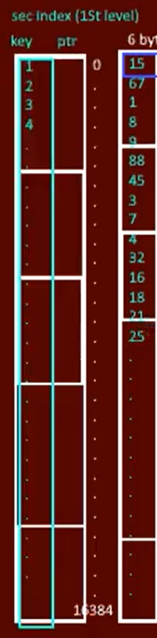
Solution:

Slide 6
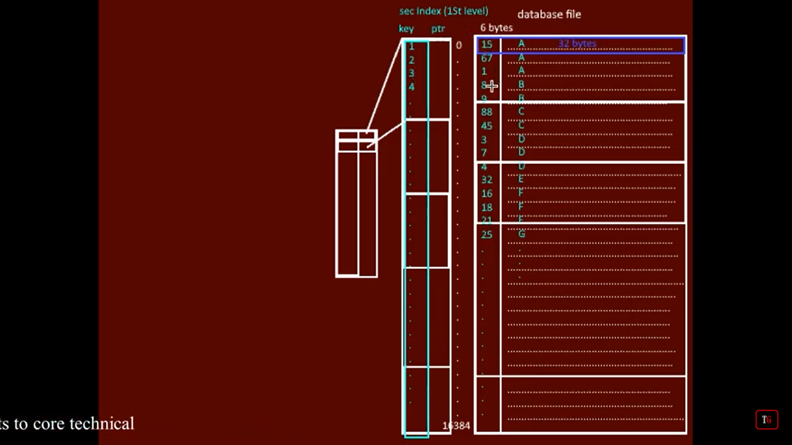
Solution:

Slide 7
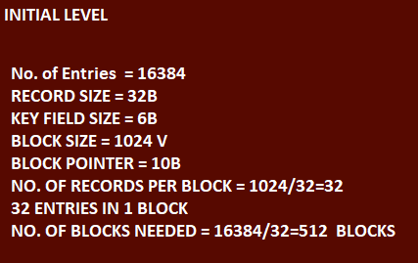
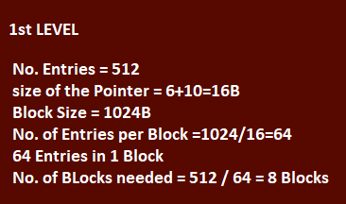
Solution:

Slide 8
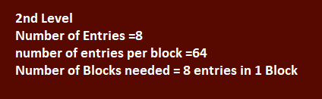
Solution:

